Slide 1
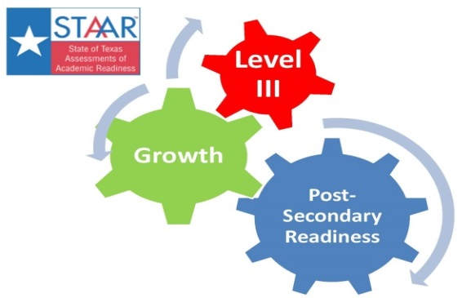
Linking Accountability and Instruction
Ty Duncan
ESC 17 Coordinator of Accountability and Compliance
@instructionalle #esc17
tduncan@esc17.net

Slide 2
Accountability
Instruction

Slide 3


#ESC17
@instructionalle

Slide 4

Pass/Fail Culture

Slide 5
From Your Demographics Are Changing at AIE 2014
“Culture hides more than it reveals, and it hides most effectively from its own participants.” – Edward T. Hall

Slide 6
Drivers
High end performance, not mere passing at low standards. Level III performance is just as important as “passing”, whatever that may be.
Special on emphasis economically disadvantaged students and Level II performance which speaks to directly to the intervention systems.
Growth, you can “pass” and still fail in Index 2.
Final Recommended Standard is the goal. Phase-in is not extremely important in an Index system.

Slide 7
Subject |  | Phase 1 | Phase 2 | Final | Level III
Reading | Grade 3 | 53% | 65% | 75% | 88%
 | Grade 4 | 52% | 66% | 77% | 86%
 | Grade 5 | 54% | 65% | 76% | 87%
 | Grade 6 | 52% | 65% | 75% | 88%
 | Grade 7 | 52% | 64% | 74% | 84%
 | Grade 8 | 50% | 63% | 75% | 85%
 | English I | 53% | 60% | 63% | 85%
 | English II | 54% | 59% | 63% | 85%
Math | Grade 3 | 59% | 72% | 83% | 91%
 | Grade 4 | 60% | 71% | 81% | 90%
 | Grade 5 | 54% | 66% | 78% | 88%
 | Grade 6 | 42% | 58% | 71% | 87%
 | Grade 7 | 44% | 56% | 69% | 85%
 | Grade 8 | 39% | 52% | 64% | 88%
 | Algebra 1 | 37% | 50% | 61% | 83%
Science | Grade 5 | 59% | 70% | 80% | 91%
 | Grade 8 | 56% | 65% | 74% | 78%
 | Biology | 37% | 51% | 61% | 83%
Social Studies | Grade 8 | 50% | 62% | 73% | 83%
 | US History | 41% | 53% | 65% | 81%
Writing | Grade 4 | 52% | 61% | 68% | 84%
 | Grade 7 | 54% | 63% | 71% | 85%
Index 1 2015
Index 3 2015
Index 1 2016
Index 3 2016
Index 4 2014
Index 4 2015
Index 3 2014
Index 3 2015
Notes:
59

Slide 8
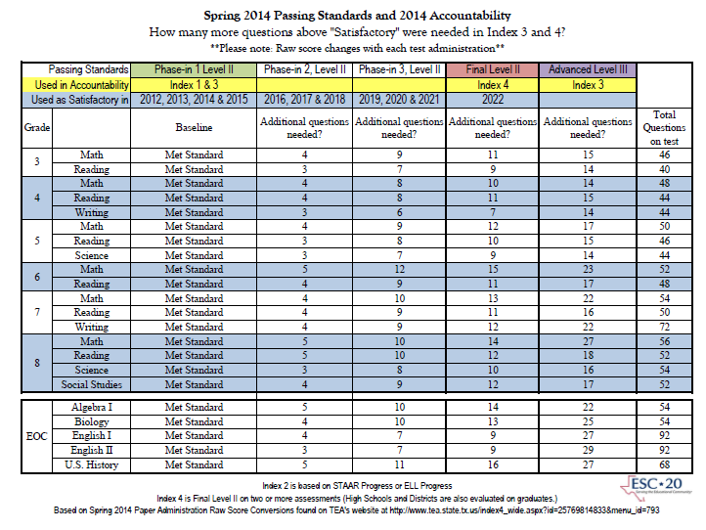
Thank You
Cheri Hendrick!
http://www.esc20.net/default.aspx?name=sup_ss.Accountability

Slide 9
To receive a Met Standard or Met Alternative Standard rating, all campuses and districts must meet the following targets on all indexes for which they have performance results in 2014.
2014 Accountability Targets [non-AEA Districts and Campuses]
 | Index 1 | Index 2 | Index 3 | Index 4
 |  |  |  | All 4 components | STAAR only
District | 55 | 16 | 28 | 57 | 13
Campus:
Elementary | 55 | 33 | 28 | N/A | 12
Middle School |  | 28 | 27 | N/A | 13
High School/K-12 |  | N/A | 31 | 57 | 21
2014 Accountability Manual Appendix L

Slide 10
Index 1: Student Achievement
2014 Target: non AEA 55 / AEA 30
Index 1: Student Achievement provides an overview of student performance based on satisfactory student achievement across all subjects for all students on BOTH general and alternative assessments.
English Language Learners (ELL) Included:
  English STAAR Two – Four Years in U.S. Schools* included using ELL Progress Measure
    STAAR L included using ELL Progress Measure
  English STAAR Five plus Years in U.S. Schools* included using Phase-in 1 Level II
  Spanish STAAR Two plus Years in U.S. Schools* included using Phase-in 1 Level II
English Language Learners (ELL) Exclusions:
English and Spanish STAAR English Language Learners (ELL) One year in U.S. Schools* excluded
*English Language Learners (ELL) Years in U.S. Schools as reported on 2014 TELPAS

Slide 11
Index 2: Student Progress
2014 Target: 5th percentile based on campus type, district 5th percentile across all campus types
Index 2: Student Progress focuses on actual student growth independent of overall achievement levels for each race/ethnicity student group, students served by special education, and English language learners.
By Subject Area: Reading and Mathematics (Writing is excluded in 2014)
Points based on weighted performance:
  One point given for each percentage of tests at the Met or exceed progress level.
  An additional point given for each percentage of tests at the Exceeded progress level.
Additional progress measures in 2014: STAAR-M, STAAR-Alt, and ELL.
High Schools/K-12 campuses as well as AEA campuses & districts will not be evaluated for Index 2 in 2014
Additional progress measures in 2014: STAAR-Modified, STAAR-Alternate, and English Language Learners (ELL).
Shaded areas are new for 2014
Notes:
ELLs?????

Slide 12
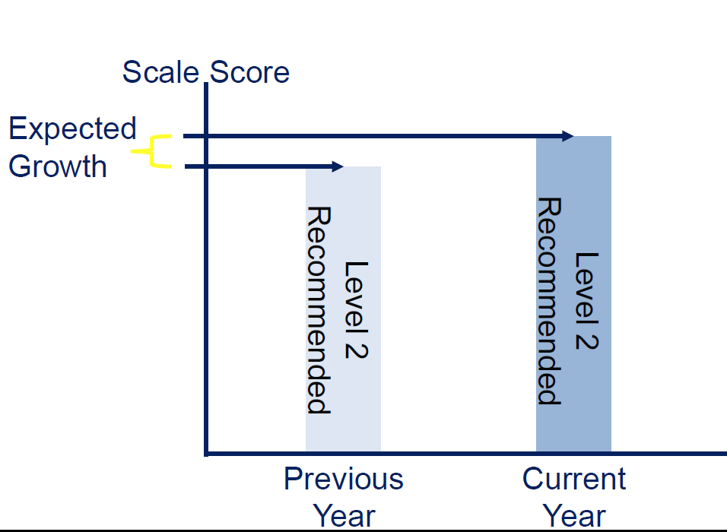
How is Growth Defined?

Slide 13
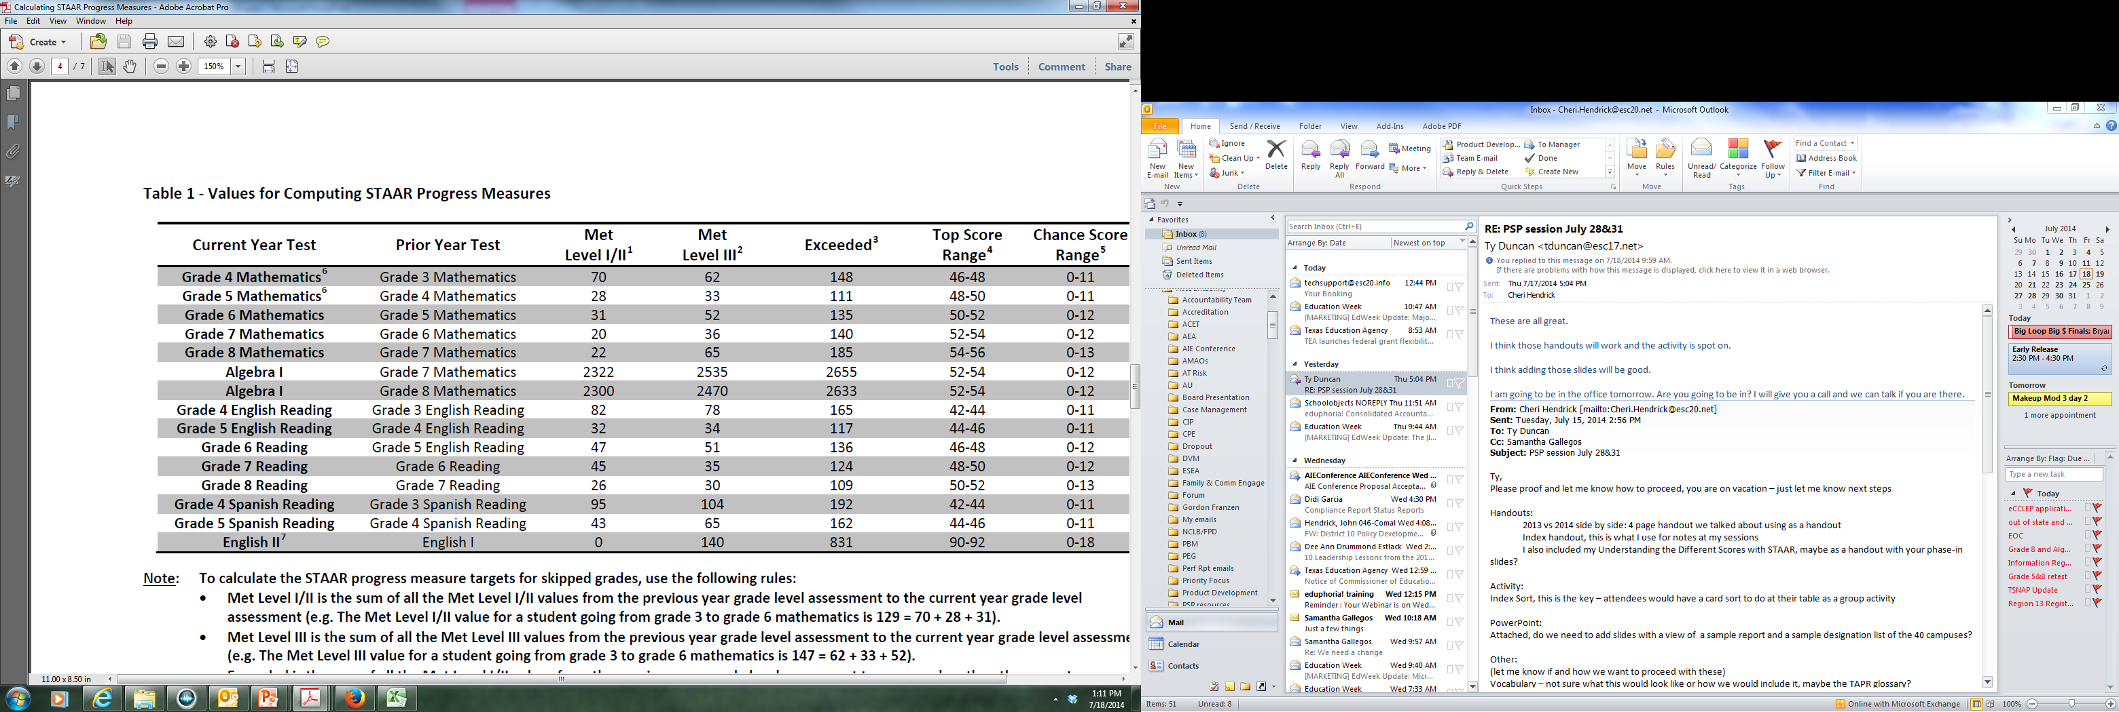
Progress Numbers
Notes:
Redo screen shoot using May 12 updates

Slide 14
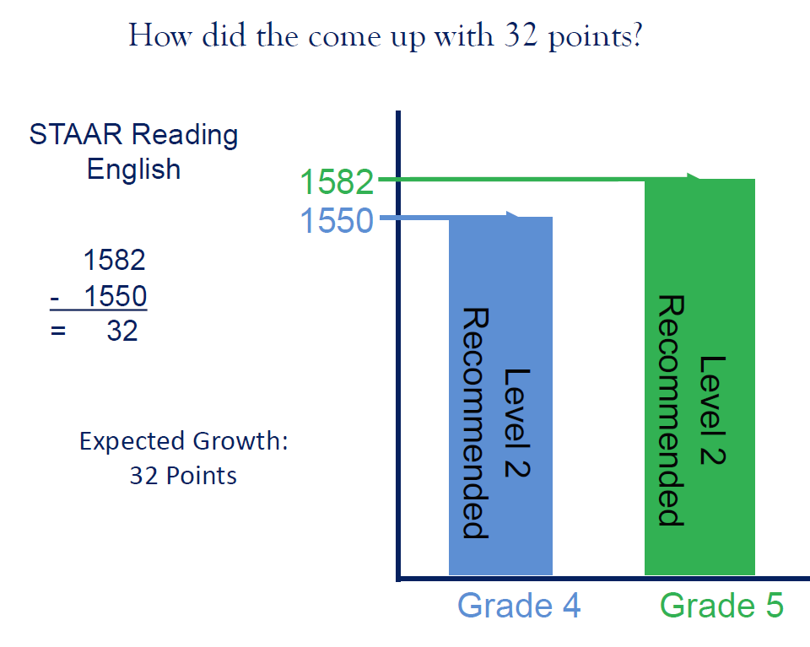
How did they come up with 32 points?

Slide 15
STAAR Grade 5 Reading Example
Expected Growth: 32 Points
Level III
1686
1684
Met Growth
1505
Not Met
1450
1458
1450
Met Growth
Phase-In 1 Level II
1324
1281
Met Growth
Grade 4
Grade 5

Slide 16

Index 3: Closing Performance Gaps
2014 Target: 5th percentile based on campus type, district 5th percentile across all campus types
Index 3: 2013 Construction – Table 1
Closing Performance Gaps emphasizes advanced academic achievement of the economically disadvantaged student group and the lowest performing race/ethnicity student groups at each campus and district.
By Subject Area: Reading, Mathematics, Writing, Science, and Social Studies
Student Groups:
  Economically Disadvantaged
  No minimum size
Two Lowest Performing Race/Ethnicity Groups
  Based on 2013 Index 1 All Subjects
  Minimum size: 25 tests in Reading and Math

Slide 17
Index 3: Closing Performance Gaps
2014 Target: 5th percentile based on campus type, district 5th percentile across all campus types
Index 3: Closing Performance Gaps emphasizes advanced academic achievement of the economically disadvantaged student group and the lowest performing race/ethnicity student groups at each campus and district.
Points based on STAAR performance:
Phase-in 1 Level II satisfactory performance:
One point for each percentage of tests at Phase-in 1 Level II (Satisfactory) or above
Level III advanced performance:
An additional point for each percentage of tests at the Level III Advanced
Level III advanced performance:
An additional point for each percentage of tests at the Level III Advanced

Slide 18
Index 4: Postsecondary Readiness
Index 4: Postsecondary Readiness emphasizes the importance of earning a high school diploma that provides students with the foundation necessary for success in college, the workforce, job training programs, or the military; and the role of elementary and middle schools in preparing students for high school.
2014 Index 4 non-AEA Targets:
Elementary Schools: 12
Middle Schools: 13
High Schools/K-12: 57 (based on all four components)*
Districts: 57 (based on all four components)*
*Non-AEA Targets If all four components :
  STAAR Final Level II,
  Graduation Score/Rate,
  Graduation Plan, and
  College-Ready Graduates are not available for high schools or districts, evaluate only the STAAR Final Level II performance at the following Index 4 targets:
    High Schools/K-12: 21
    Districts: 13
Notes:
Use new definition from 2014 manual

Slide 19
Accountability
Instruction

Slide 20
Action Item # 1
Changing the Questions The Teachers Ask When They Get Data!
How many Level III students do we have?
How many Level II students are just below Level III?
Are students making progress to the Level II Final Recommended Standard?
How am I going to differentiate to ensure all students make progress?

Slide 21
Action Item #2
Create Intervention/Enrichment for Level III students to keep them there!!
Level III is just as important as passing in this system.
Not maintaining Level III students in this system will negatively impact Index 2 and 3 and could lead to IR rating regardless of how many students “passed.”

Slide 22
Action Item #3
Exposure to “high brow” intellectualism everyday!
But in a landmark book this year, two sociologists, Angel L. Harris of Duke and Keith Robinson of the University of Texas at Austin, found that many things parents obsess over—checking homework nightly, volunteering at their kids' schools—have no measurable impact on student achievement. http://m.us.wsj.com/articles/four-ways-to-spot-a-great-teacher-1409848739?mobile=y
  Great teachers have active intellectual lives outside their classrooms.
  Economists have discovered that teachers with high SAT scores or perfect college GPAs are generally no better for their students than teachers with less impressive credentials. But teachers with large vocabularies are better at their jobs because this trait is associated with being intelligent, well-read and curious.
  In 1903, W.E.B. Du Bois, who once taught in a one-room schoolhouse in rural Tennessee, wrote that teachers must "be broad-minded, cultured men and women" able to "scatter civilization" among the next generation. The best teachers often love to travel, have fascinating hobbies or speak passionately about their favorite philosopher or poet.

Slide 23
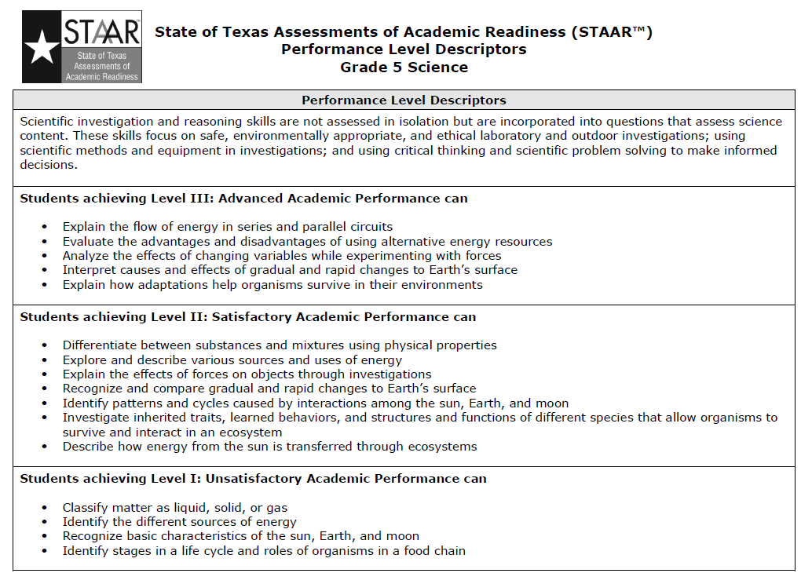

Slide 24
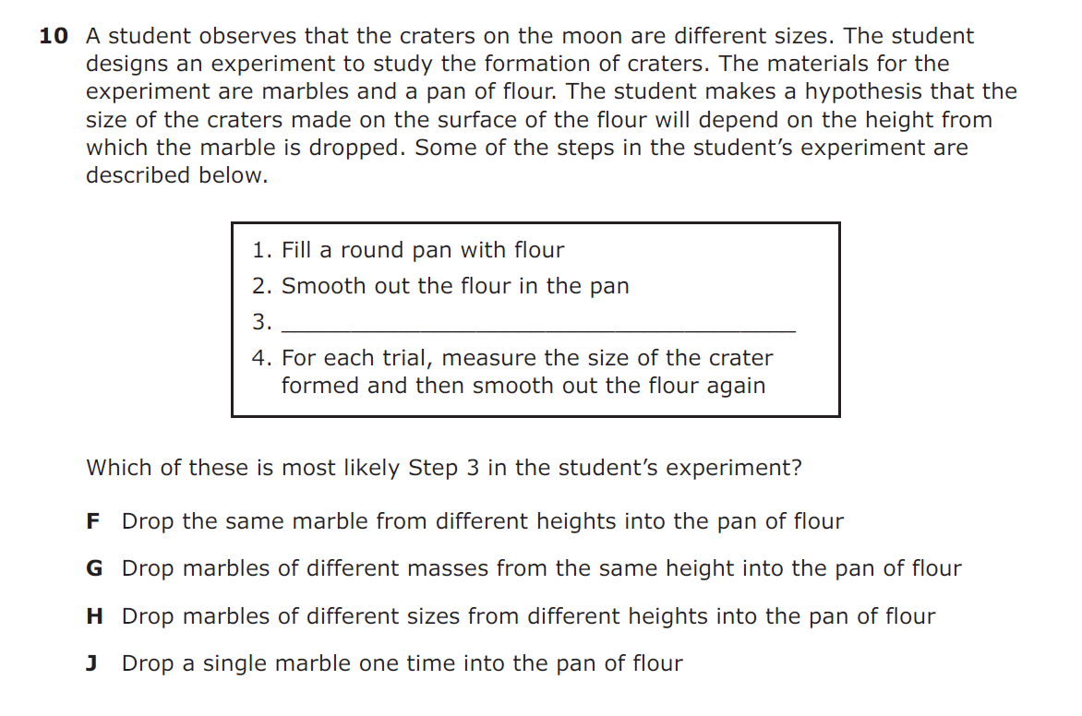
Grade 5 Science – 50% correct in Texas 2014

Slide 25
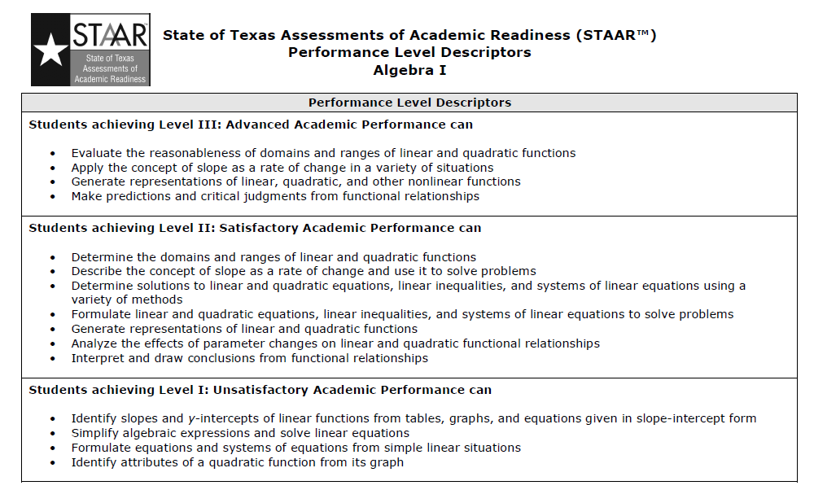

Slide 26
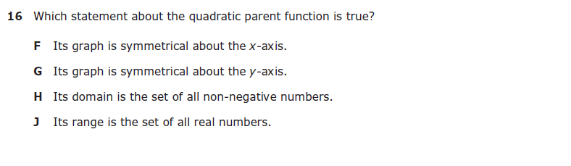
Algebra I EOC – 36% Correct in Texas in 2014!

Slide 27
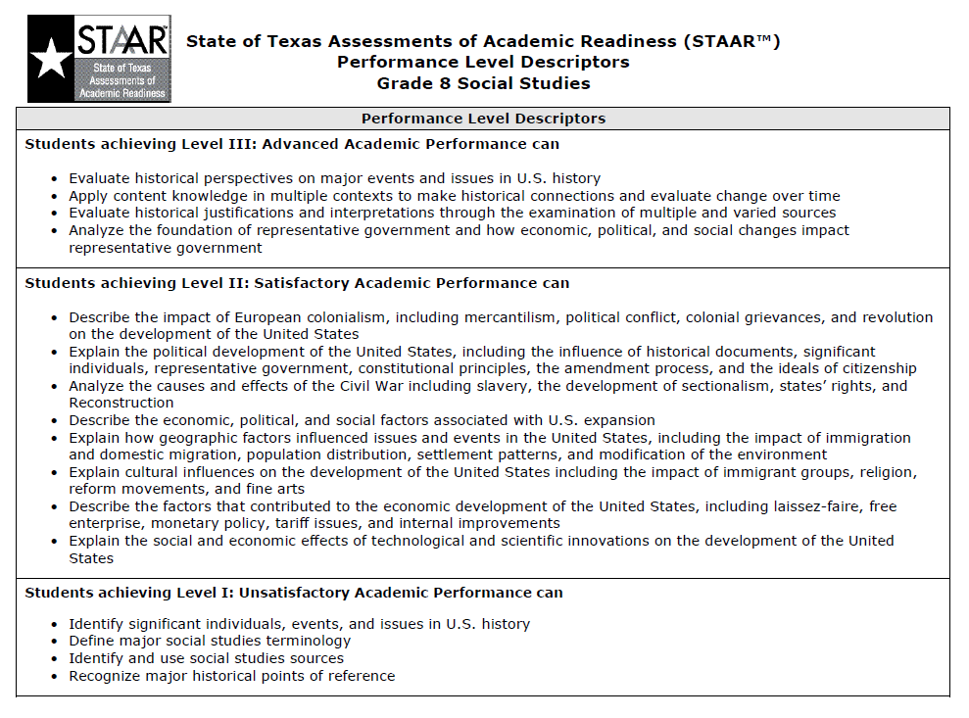

Slide 28
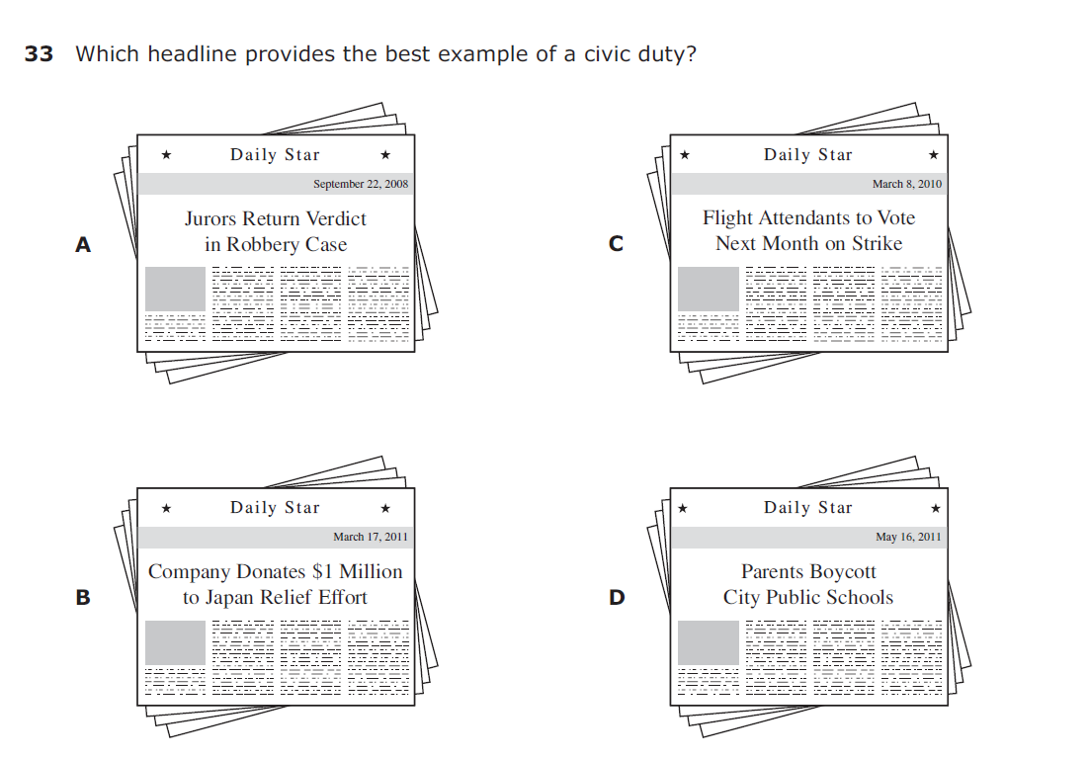
8th Grade Social Studies – 37% Correct in 2014

Slide 29
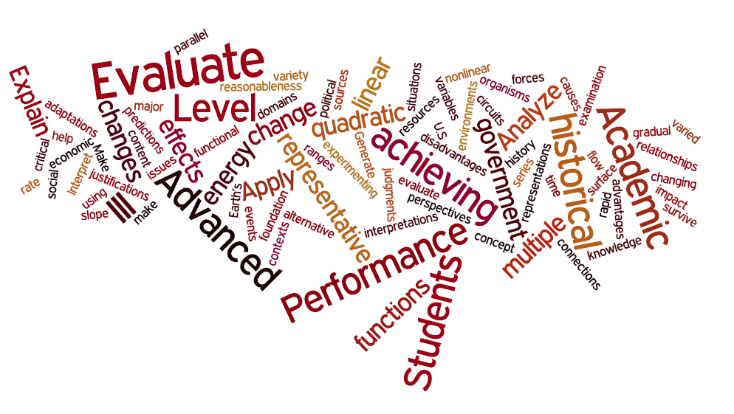
Word Cloud of Level III on STAAR

Slide 30
Action Item #4
Creating a climate where teachers “grind” everyday!
Student growth is an everyday, all day affair.
Gaps in instruction no matter how small or inconsequential they may seem can make or break students with little background knowledge.
Teacher attendance and attention to each child is paramount for Index 2 and ELL success.

Slide 31
Phases of Teaching:
Attitudes Toward Teaching
We must engage in reflective conversations with our faculty to get us on the upward path to renewed energy and enthusiasm!
“People often say that motivation doesn't last. Well, neither does bathing - that's why we recommend it daily.”– Zig Ziglar
Copyright 1998, Austin Educational Associates
Notes:
Moir, 1990

